Slide 1
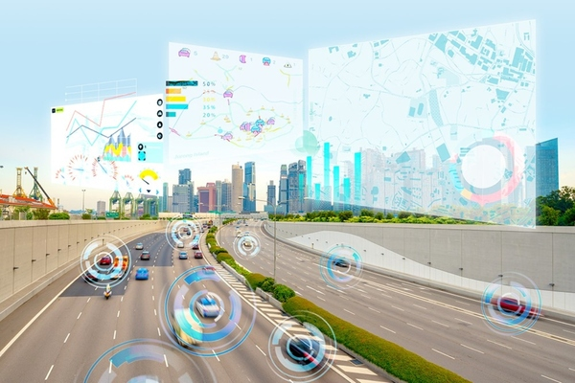
IntelligentUrbanMobilityAnalyticsUsing GPS and TrafficData​

Slide 2
Abstract
Intelligent Urban Mobility Analytics Using GPS and Traffic Data is an AI-based system designed to analyze and improve transportation in urban areas. The system collects real-time and historical data from GPS devices, vehicles, and traffic sources to understand traffic patterns, vehicle movement, congestion levels, and travel times. Artificial Intelligence techniques are used to process this data and identify congested routes, predict traffic conditions, and suggest efficient travel paths. It can predict possible traffic congestion and help users and traffic authorities make better decisions regarding route planning and traffic management. This aims to reduce traffic congestion, travel time, and improving road utilization and urban mobility. The integration of GPS data, traffic analytics, AI-based prediction, and automated decision-making makes the system useful for smart-city transportation management.

Slide 3
Problem Statement
Rapid urbanization and the growing number of vehicles have led to traffic congestion, road accidents, and longer travel times, affecting road safety and transportation efficiency. Existing systems often analyze GPS, weather, and accident data separately, limiting comprehensive mobility analysis.
This project develops an Intelligent Urban Mobility Analytics platform that integrates GPS trajectory, weather, and road accident data to analyze mobility patterns, predict accident risks, and provide actionable insights through an interactive dashboard for smarter transportation planning.

Slide 4
Objectives
To analyze urban mobility patterns using GPS trajectory data.
To study the impact of weather conditions on transportation and travel behavior.
To identify accident-prone conditions through road accident data analysis.
To perform data cleaning, integration, and exploratory data analysis (EDA) for meaningful insights.
To develop machine learning models for accident risk prediction and mobility analysis.
To visualize mobility trends using interactive maps, charts, and dashboards.
To generate data-driven insights that support smarter transportation planning and smart city initiatives.

Slide 5
Research Gap Identification
Limited Data Integration: GPS, weather, traffic, and accident data are often studied separately.
Limited Combined Insights: Their relationships are not sufficiently analyzed together.
Limited Explainability: SHAP and LIME are not widely integrated into mobility prediction systems.
Limited Unified Platform: Existing systems often lack combined analysis, prediction, comparison, and visualization.
Limited Interactive Analytics: There is a need for a single dashboard integrating routes, hotspots, predictions, and reports.

Slide 6
innovation
Multi-Source Urban Mobility Integration: Combines GPS trajectory, weather, traffic, and accident data in a unified analytics platform.
AI-Based Accident Risk Prediction: Uses Decision Tree, Random Forest, XGBoost, and Logistic Regression to identify accident-risk patterns.
Explainable AI: Uses SHAP and LIME to explain why the models predict a particular accident risk.
Geospatial Mobility Insights: Uses GPS coordinates to visualize routes, mobility patterns, and accident hotspots on interactive maps.
Integrated Intelligent Dashboard: Combines mobility analytics, weather impact, accident analysis, predictions, and visual reports in one dashboard.
Future-Ready Architecture: Can be extended with real-time GPS, live traffic data, smart route recommendations, cloud deployment, and mobile applications.

Slide 7
feasibility
Data Availability: Required datasets are publicly available.
Technical Feasibility: Can be developed using Python, Pandas, Scikit-learn, XGBoost, SHAP, and LIME.
Computational Feasibility: Models can run on a standard laptop.
Integration Feasibility: GPS, weather, and accident data can be integrated for unified analysis.
Implementation Feasibility: Can be developed step-by-step from data processing → ML → dashboard.
Future Feasibility: Can be extended with real-time GPS, live traffic, smart routes, cloud, and mobile applications.

Slide 8
Project plan
Phase 1 – Data Preparation: Collect datasets, clean, integrate, handle missing values and perform EDA.
Phase 2 – Feature & Predictive Analytics: Create mobility features and develop Decision Tree, Random Forest, XGBoost, and Logistic Regression models.
Phase 3 – Explainable AI & Visualization: Use SHAP and LIME with GPS maps, heatmaps, traffic, weather, and accident visualizations.
Phase 4 – Integrated Dashboard: Combine analytics, predictions, maps, and insights into an interactive dashboard.
Phase 5 – Validation & Research Output: Validate models, improve performance, document results, and prepare the final project and research output.

Slide 9
Thank you
BATCH NO – 07
Team members
2420030066 - P.Likhith
2420030225 – Sanivarapu Sadhana
2420030336 - M.Pavani Sree

